Slide 1
Face Recognition and Detection using Tensorflow.
Members of the team:
Tomasz Baldach
MIGUEL ANGEL VAZQUEZ ROA

Slide 2
Outline.
Face recognition
Motivation
Parts of the process
Detection of the faces
Face recognition
Data for comparison
Results

Slide 3
Face recognition.
Process an image to extract biometric information
Starts by detecting a face on an image
Nowadays is in use on important security areas

Slide 4
Motivation.
Discover the most common methods and algorhms use nowadays.
Learn how to apply the Computer Vision in this area.
Observe one of the biggest areas in Computer Vision today.

Slide 5
Parts of the Process.
Detection of the faces in the given image.
In this part we have to find the location of the faces in image
Extraction of the biomedical measures of the fase.
Here we have to use the locatios previusly found to generate the needed data form the image
Obtaining the information to compare with the image
In order to compárate the extract information we have count with data previously learn.
Face recognition
Comparation to the data to search for the similarities.

Slide 6
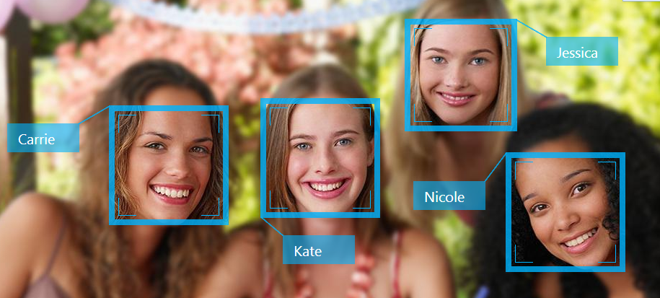
Detection of the faces.
Consist in find the location and the sizes of the faces.

Slide 7
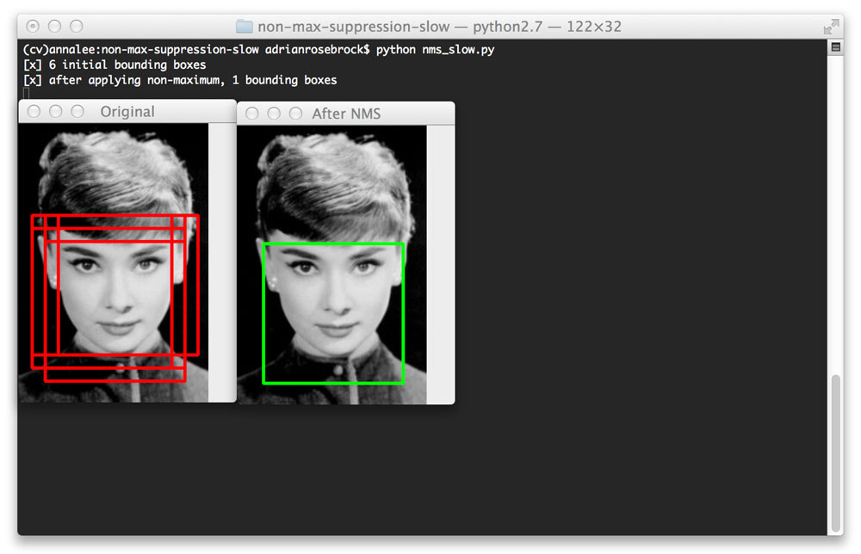
Detection of the faces.
We use MTCNN (Multi-task Cascaded Convolutional Neural Networks) this is an algorithm implemented by tensorflow.
This algorithm give us the opportunity to find the bounding boxes of the faces.

Slide 8
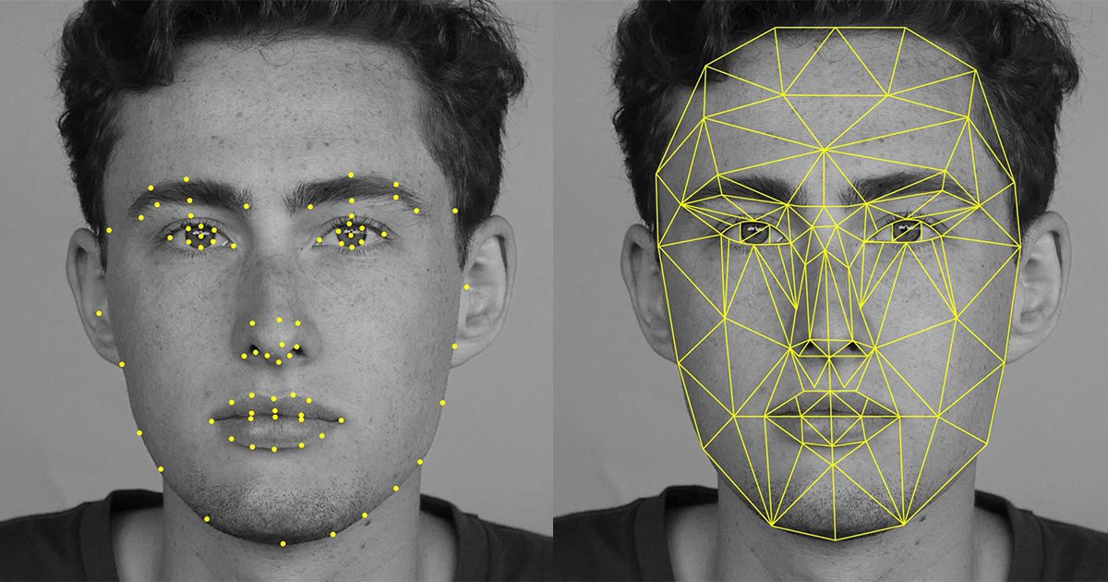
Face recognition.
Get the features of a face by measuring the distance between eyes, nose and mouth.
Then FaceNet that directly learns a mapping from face images to a Euclidean space.

Slide 9
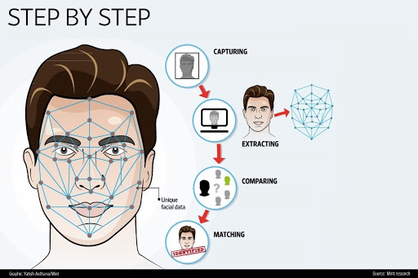
Face recognition.
Find for a match in a data base.

Slide 10
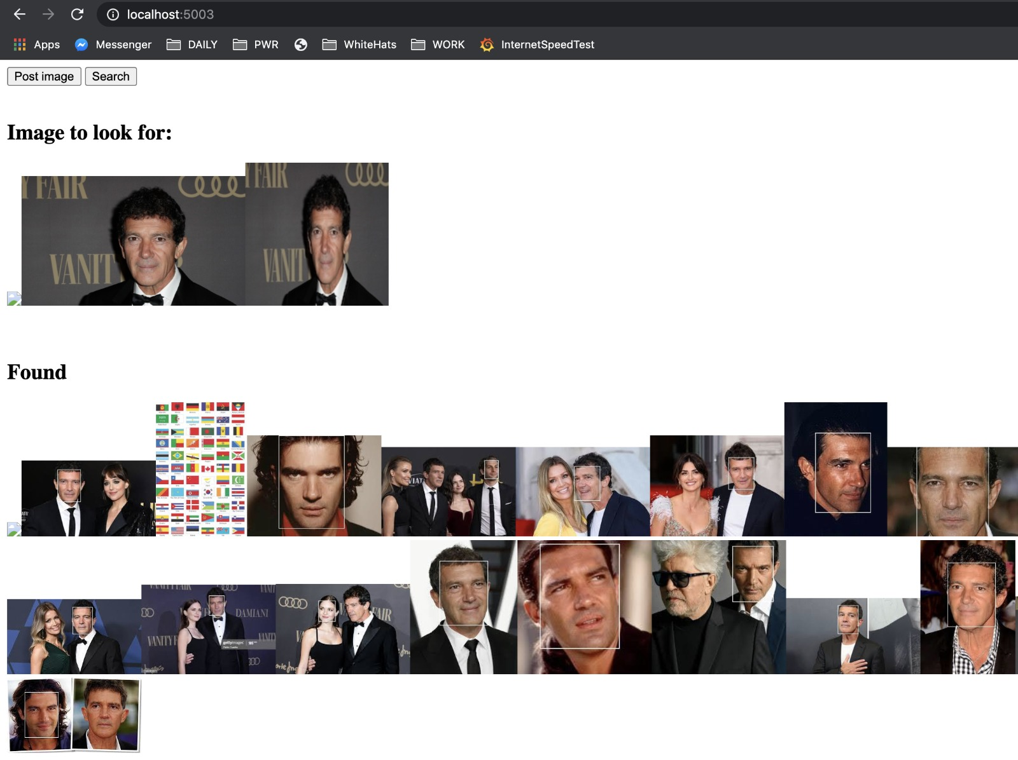
Data for comparation
Search for images in Google for finding matches between the data.

Slide 11
Results.

Slide 12



Thanks for your attention.

